Slide 1
Enzyme Trial 2 formal Presentation
Group 6:
Nathan Ketterlinus, Ny’Gia Williams,
Eleyna McNeil, Dara Oyefusi

Slide 2
Introduction - Enzymes
Enzyme: A biological catalyst that accelerates specific chemical reactions (Genome.gov, 2024)
Typically a protein (Genome.gov, 2024)
Lower a reaction’s activation energy (Cooper, 2000)
Substrates bind to active site of enzyme (Cooper, 2000)
Lock-and-key model
Induced fit
Catalyzed reactions occur millions of times faster than uncatalyzed ones (Libretexts, 2021)
~4,000 biochemical reactions are catalyzed (Libretexts, 2021)
Organisms require many of these to survive
Important for organisms to digest macromolecules (Libretexts, 2021)

Slide 3
Introduction - Trypsin
Trypsin: catalyzes the hydrolysis of protein molecules
Breaks down proteins to peptides and amino acids (Vertiprakhov & Ovchinnikova, 2022)
Crucial in digestion for many organisms
Secreted in the pancreas (Vertiprakhov & Ovchinnikova, 2022)
Digests Sulfanilamide groups in Azocasein.
Sulfanilamide absorbs light @ 440nm -> increased trypsin activity correlated with increased absorbance @ 440nm
Secreted in the pancreas, active in the small intestine (Infoplease, 2017)
~pH 8

Slide 4
Introduction - Hypothesis
Question:
What are the optimal conditions for Trypsin activity?
Hypothesis:
Trypsin’s activity will be highest at pH 9, 0.15M NaCl, at 75°C
Rationale:
Based on previous testing,
Trypsin activity increases with temperature up to 50 °C.
No observed indication that this will change
pH 9 and 0.15M NaCl based on other groups testing,
Higher pH correlated with more activity

Slide 5
Material & Methods - Procedure
1. For each sample, add to a centrifuge tube (Lab Manual, 2024):
450 μl Reaction Buffer (pH 9, 0.15M NaCl)
500 μl Azocasein
Azocasein contains sulfanilamide groups, which are red/orange (~440nm).
Digestible by trypsin -> higher absorbance at 440nm = higher trypsin activity
50 μl Trypsin (Water in negative controls)
2. Incubate for 10 minutes at target temperature (Lab Manual, 2024)
Measured 5 replicates and 3 negative controls at 50°C, 55°C, 60°C, 65°C, 70°C, 75°C

Slide 6
Material & Methods – Procedure Cont’d
3. Add 500 μl of 10% TCA (Lab Manual, 2024)
Stops reaction
Precipitates undigested substrate
4. Centrifuge tube at max speed for 2 minutes
Pellets undigested substrate (Lab Manual, 2024)
Ensures absorption measurement is just of what trypsin digested.
5. Transfer supernatant to a clean cuvette (Lab Manual, 2024)
6. Blank spectrophotometer with water (Lab Manual, 2024)
7. Measure absorbance at 440 nm (Lab Manual, 2024)

Slide 7
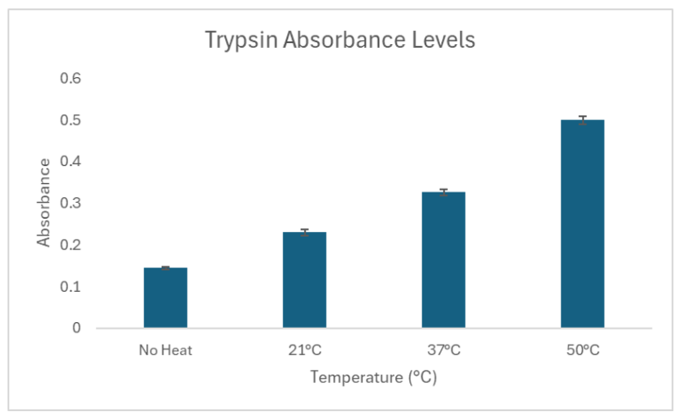
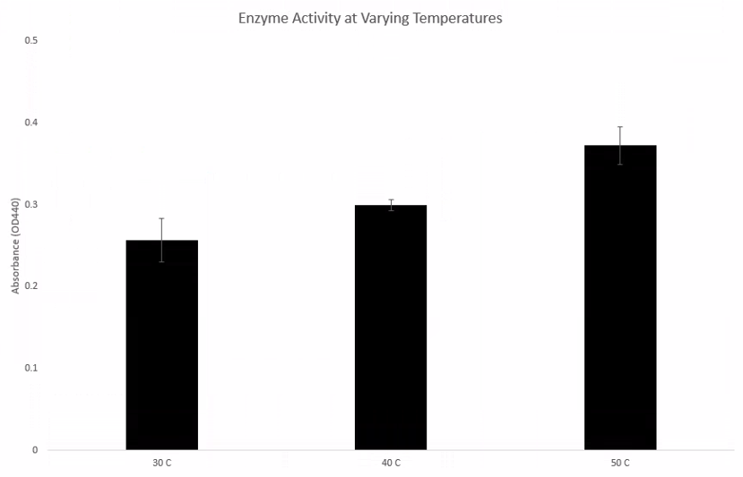
Material & Methods – Rationale
Why pH 9, 0.15M NaCl?
Showed the highest activity in other group’s experiments.
Note that salinity was never tested, this is our best guess.
Why 50°C, 55°C, 60°C, 65°C, 70°C, 75°C?
Continues research from our previous experiment, as well as data from group 4
50°C has significantly higher activity than 30°C & 40°C
Group 4
Experiment 1
Group 6
Experiment 1

Slide 8
Material & Methods – Negative Controls
Negative controls created and manipulated identically to trials
Except: 50 μl Trypsin replaced with 50 μl water
Why?
To test baseline activity without enzyme
(enzyme activity) – (baseline activity) = effect of trypsin
3 negative controls for each tested temperature
5 replicates for regular trials
Provides consistency across results
can identify outliers

Slide 9
Results - Data
Temp | 50C | 55C | 60C | 65C | 70C | 75C
Trial 1 | 0.50 | 0.47 | 0.42 | 0.32 | 0.35 | 0.32
Trial 2 | 0.54 | 0.50 | 0.41 | 0.36 | 0.34 | 0.29
Trial 3 | 0.52 | 0.46 | 0.50 | 0.37 | 0.39 | 0.36
Trial 4 | 0.50 | 0.46 | 0.53 | 0.31 | 0.32 | 0.30
Trial 5 | 0.52 | 0.47 | 0.49 | 0.32 | 0.34 | 0.31
TrialAvg | 0.52 | 0.47 | 0.47 | 0.33 | 0.35 | 0.32
Control 1 | 0.10 | 0.09 | 0.09 | 0.09 | 0.09 | 0.08
Control 2 | 0.08 | 0.08 | 0.08 | 0.09 | 0.09 | 0.11
Control 3 | 0.09 | 0.08 | 0.09 | 0.10 | 0.09 | 0.08
ControlAvg | 0.09 | 0.08 | 0.08 | 0.09 | 0.09 | 0.09
Normalized | 0.43 | 0.39 | 0.39 | 0.24 | 0.26 | 0.23
STDEV | 0.02 | 0.02 | 0.05 | 0.03 | 0.02 | 0.03
Null Hypothesis | P Value | Result
The absorbance at 55C is NOT significantly different than the absorbance at 50C | 0.005040671 | Significant
The absorbance at 60C is NOT significantly different than the absorbance at 50C | 0.098884025 | Not Significant
The absorbance at 65C is NOT significantly different than the absorbance at 50C | 0.000001609 | Significant
The absorbance at 70C is NOT significantly different than the absorbance at 50C | 0.000001587 | Significant
The absorbance at 75C is NOT significantly different than the absorbance at 50C | 0.000000796 | Significant
Recall P-values (obtained from T-Tests) refer to the likelihood that observed differences are because of experimenting.
Values <.05 are taken to be significant indicators of difference due to experimental design instead of random chance.
Recall Standard Deviation (STDEV) refers to variance within a sample.

Slide 10
Results - Key Insights
Trypsin has the highest activity at either 50°C or 60°C
50°C had 10.26% higher absorbance than 55°C
This is based on P-values calculated on the last slide
Results for 60°C had a much larger variance than all other tests
Could be due to experimenter error (ie poor mixing, etc)

Slide 11

Discussion - 1
We believe that the experimental design and execution was inadequate to test the hypothesis.
We did not have enough information to determine the optimal salinity or pH.
There may be more optimal buffer configurations that allow for higher trypsin activity.
Our experiment did not support our hypothesis
50°C was shown to allow trypsin to have statistically significantly more activity than the hypothesized value of 75°C
86.96% higher activity
From our data:
Temp | 50C | 55C | 60C | 65C | 70C | 75C
Normalized | 0.43 | 0.39 | 0.39 | 0.24 | 0.26 | 0.23

Slide 12
Discussion – Collaboration
Drawing from Group 4’s work:
50°C appears to be the optimal temperature across groups
Both us and Group 4 found 50°C to be statistically significantly more effective than lower temperatures (40°C and 37°C respectively)
This experiment shows that above 50°C, performance starts to drop off (apart from 60°C, which looks to be caused by poor execution and is thus excluded)
Group 4
Experiment 1

Slide 13
Discussion – Control Variables
We controlled samples to pH 9, 0.15M NaCl
This was driven by data from groups 2 and 5, that found that the difference between pH 9 and pH 8 was statistically significant.
Group 1’s graph also seemed to indicate this, but there was too much variability to conclude statistical significance

Slide 14
Discussion – Sources of Variability
Potential sources of variability
Poor pipetting
Minor impact, pipettes were verified at the right volume before adding each substance
Poor mixing
Medium impact; with 45 samples, some may have been skipped or improperly mixed
Smudged cuvettes
Minor impact overall, shouldn’t have happened more than once
Samples 3, 4, and 5 @ 60 °C look to be the most unusual values, these errors could have happened there.

Slide 15
Discussion – Future improvements
For future experimentation, we should limit temperature values to between 40°C and 60°C, as this range has statistically higher activity than outside it.
Control variables should be updated to reflect new, conclusive findings by other groups
Since variability between negative controls is so low, an average value of ~.09 can be taken to streamline the experimenting process.
This lets us as experimenters take more care with trial samples.
Ensure samples are pipetted and mixed properly, and that cuvettes are not smudged

Slide 16
Citations
Cooper, G. M. (2000). The Central Role of Enzymes as Biological Catalysts. The Cell - NCBI Bookshelf. https://www.ncbi.nlm.nih.gov/books/NBK9921/
Enzyme. (2024, November 9). Genome.gov. Retrieved November 10, 2024, from https://www.genome.gov/genetics-glossary/Enzyme
Infoplease. (2017, January 24). Trypsin. InfoPlease. https://www.infoplease.com/encyclopedia/science/biochemistry/concepts/trypsin
Libretexts. (2021, March 6). 1.17: Enzymes. Biology LibreTexts. https://bio.libretexts.org/Bookshelves/Introductory_and_General_Biology/Introductory_Biology_(CK-12)/01:_Introduction_to_Biology/1.17:_Enzymes
Vertiprakhov, V. G., & Ovchinnikova, N. V. (2022). The activity of trypsin in the pancreatic juice and blood of poultry increases simultaneously in the postprandial period. Frontiers in Physiology, 13. https://doi.org/10.3389/fphys.2022.874664
Lab Manual
Group 4 PPTX1

